Slide 1
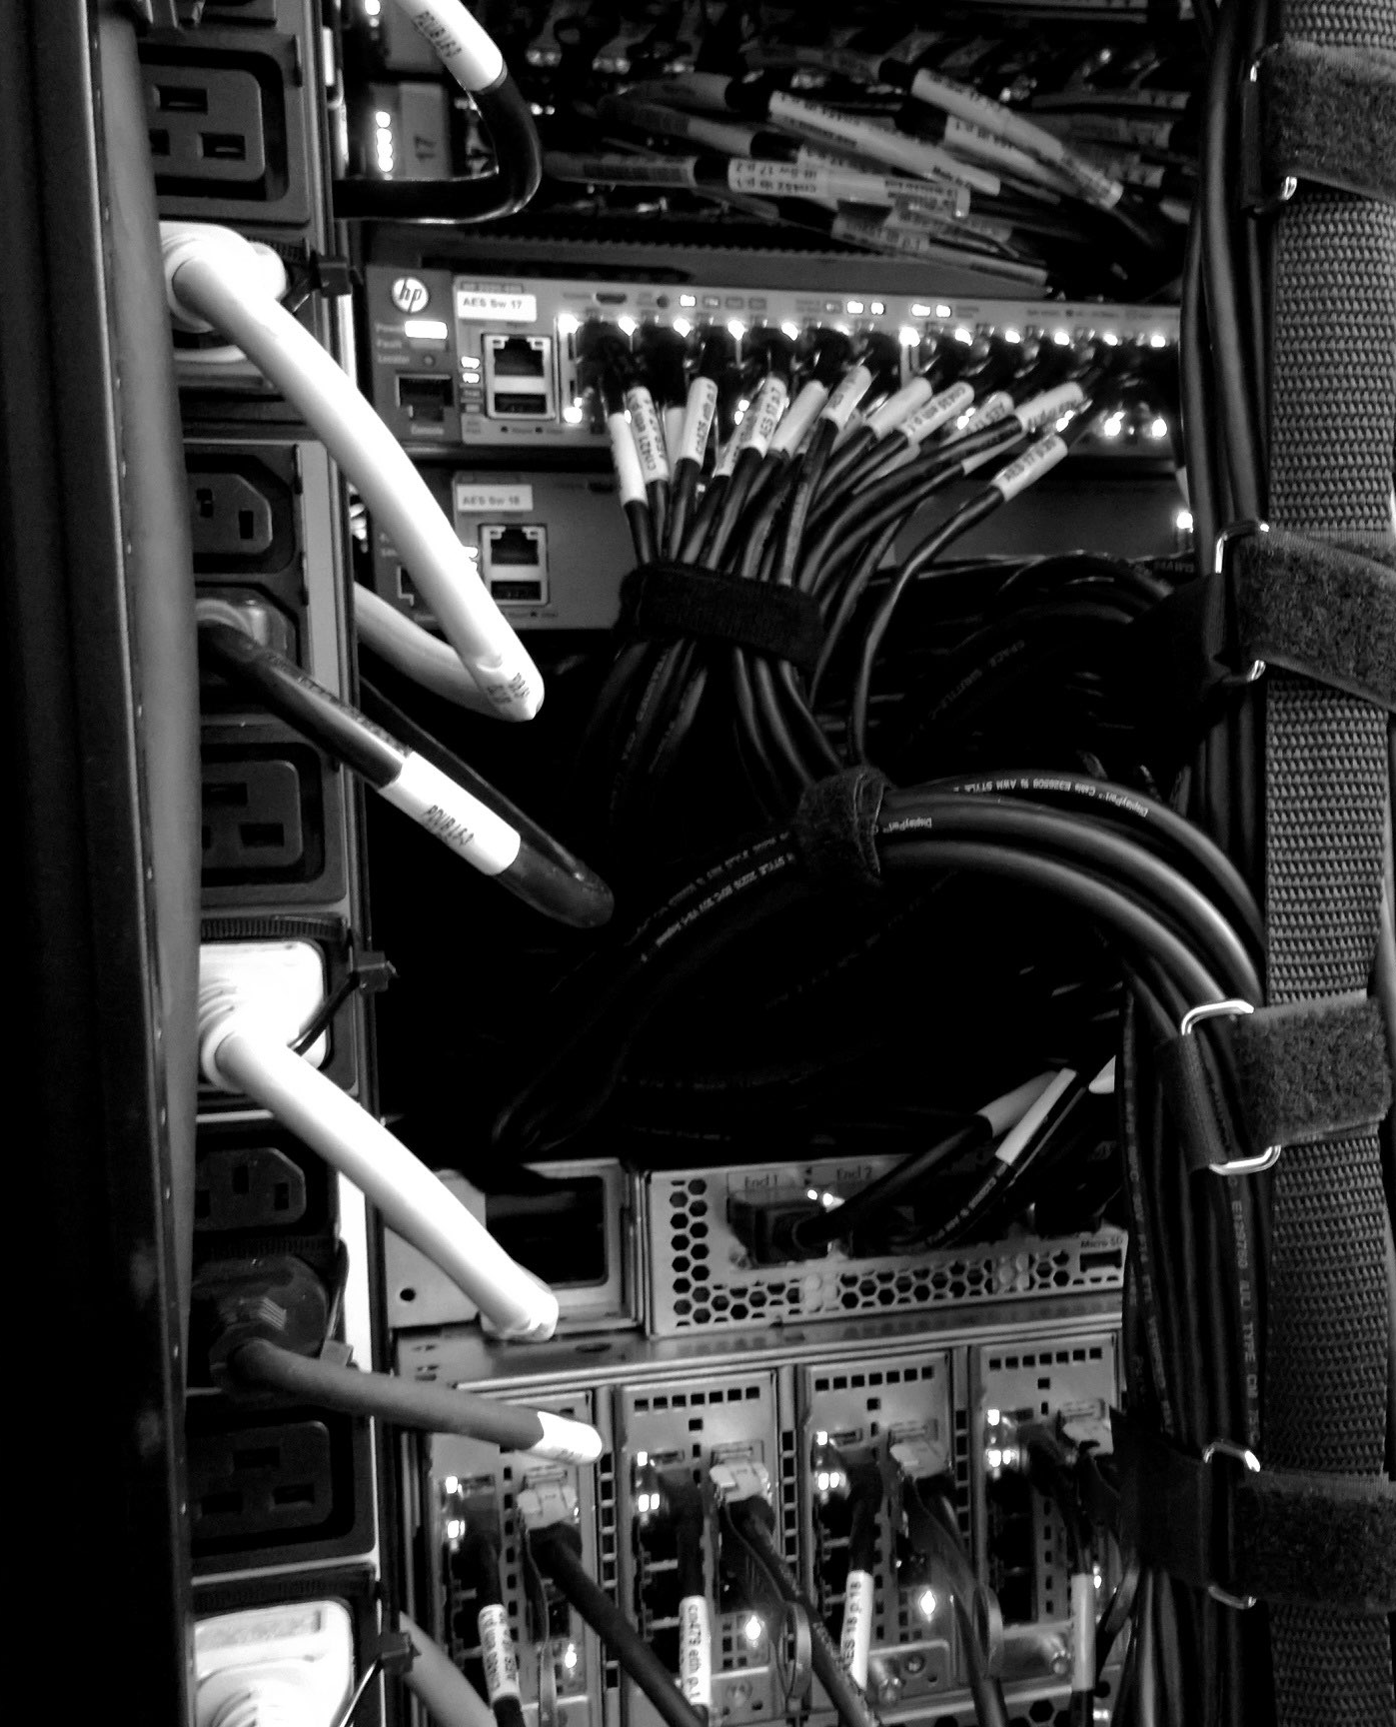

COMPUTEROME 2.0
USERS WORKSHOP
Center for Health DATA SCIENCE (HEADS)
Faculty of Health and Medical Sciences,
University of Copenhagen, February, 2021

Slide 2

02
CENTER FOR HEALTH DATA SCIENCE
SERVICES
TRAINING
RESEARCH
Provide SUND researchers with health data science services and provide training.
Courses
Workshop
Seminars
Conferences
Heath Data
Internal Projects
External Projects
Grants
Consultancy
Collaboration
Matchmaking
Establish health data science as a topic in its own right and conduct its own research.
Started March 2020.
Located at Panum Institute.

Slide 3
04
4
CENTER FOR HEALTH DATA SCIENCE
CPR
RESEARCH
BIO- STAT
HeaDS is a Hub for health data science research.
The Hub will connect groups and sections at SUND (spokes) within the field of data science research:
Coordination
Collaboration
Workshops, Seminars, …
Visibility
Visibility
HUB
Center for Health
Data Science
GLOBE
The Center will seek to obtain external funding to fuel more research in health data science - groups within the Center.
BRIC
(…)

Slide 4
05
7
DATA SCIENCE LAB – SERVICES
CENTER FOR HEALTH DATA SCIENCE
An essential part of the Centers activities is Support and Service for SUND researchers.
General services (Computerome, data-mangement etc.) or more specialized (e.g., NGS analysis).
Collaboration with HeaDS Data Lab (agreement on payment and/or co-authorships before-hand).
Discussion of data science questions, resulting in referral to other data lab.
CONSULTATON
MATCHMAKING
REFERRAL
COLLABORATION
Discussion of data science questions, resulting in ideas, guidance, tips and analysis.
Connection of researchers with common interests, and complementary skills for collaboration.

Slide 5


RESEARCH
06
9
DATA SCIENCE LAB - COURSES
CENTER FOR HEALTH DATA SCIENCE
Course Coordination:
Python Tsunami, Spring 2021 (two times).
R courses:
From Excel to R (module 1) - Right now!
More R modules in collaboration biostatistics.
R
COURSES
Git/Github Workshop (Reproducible Science):
April, 2021.
WORKSHOPS
Computerome 2.0 Users Workshop:
February, 2021 - Collaboration Globe & Danstem
SEMINARS
CONFERENCES
Analysis of Next Generation Sequencing Data
Summer, 2021.

Slide 6
COMPUTEROME 2.0
USERS WORKSHOP
Center for Health DATA SCIENCE (HEADS)
Faculty of Health and Medical Sciences,
University of Copenhagen, February, 2021

Slide 7
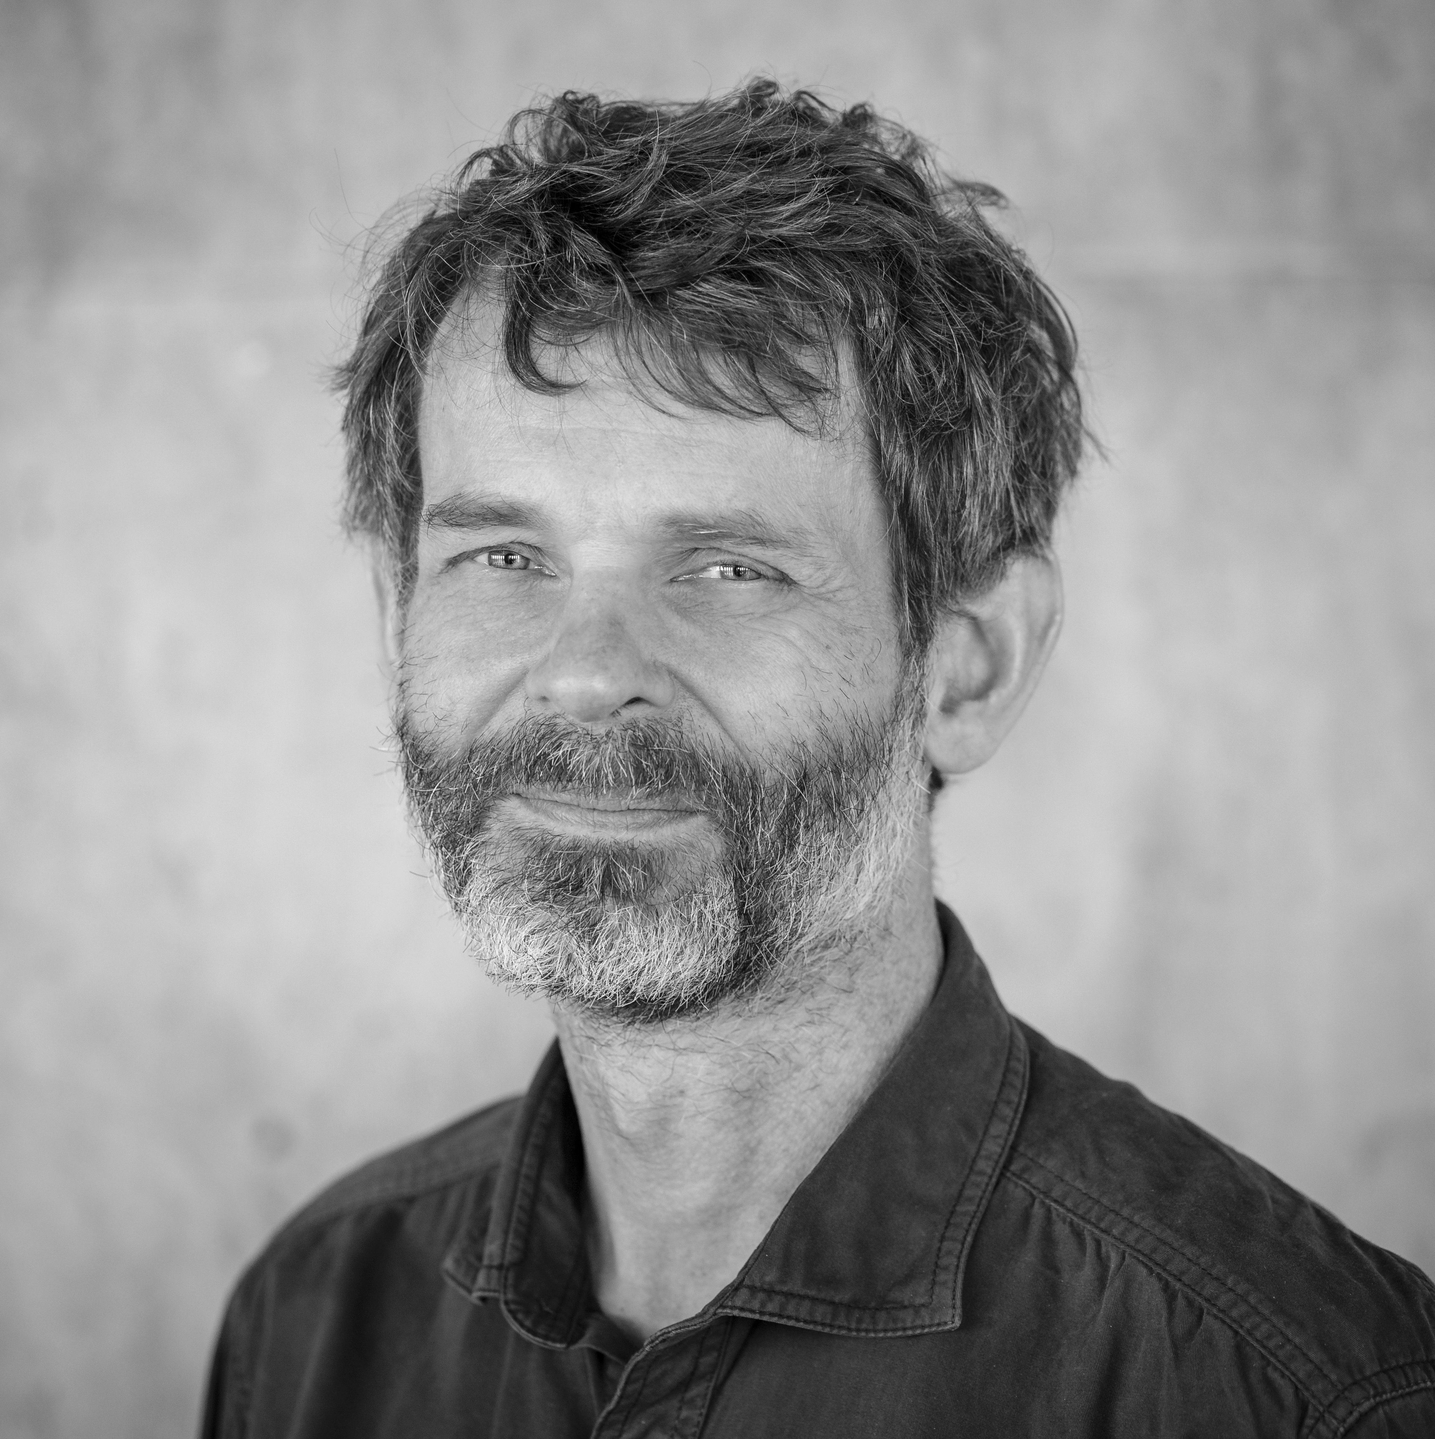
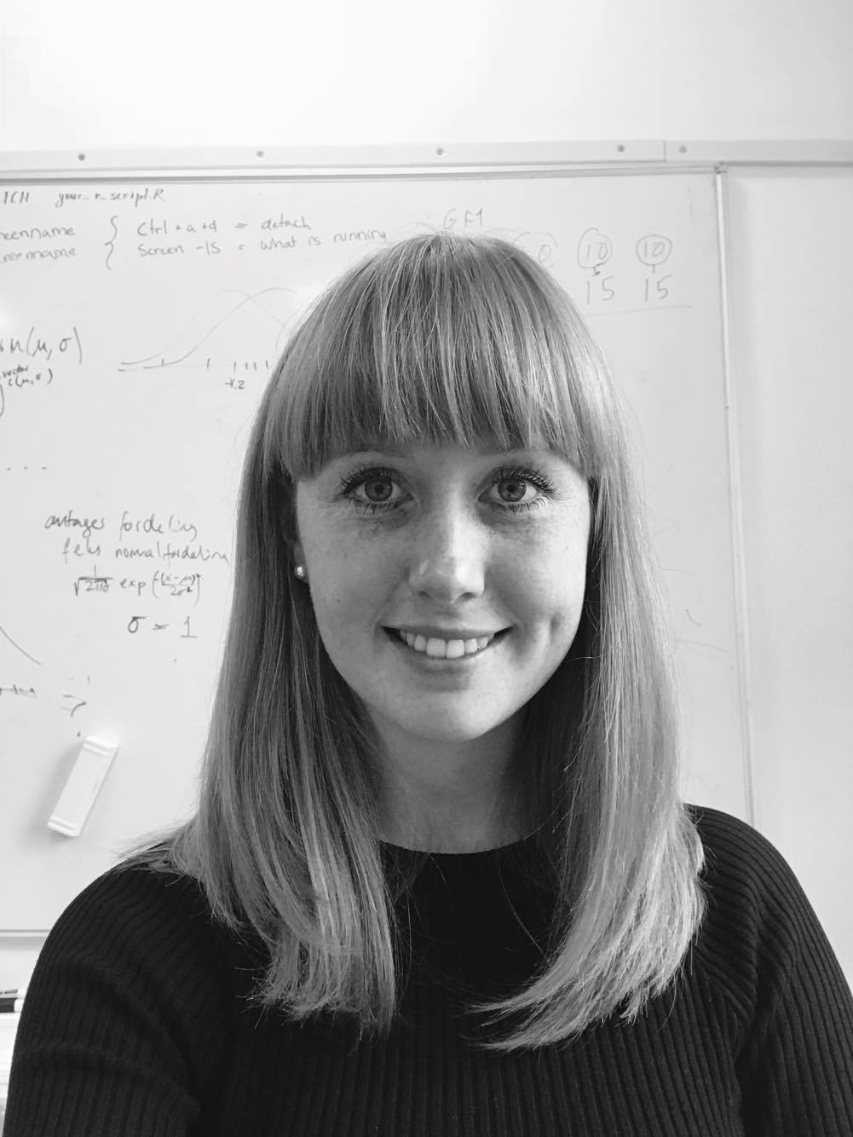
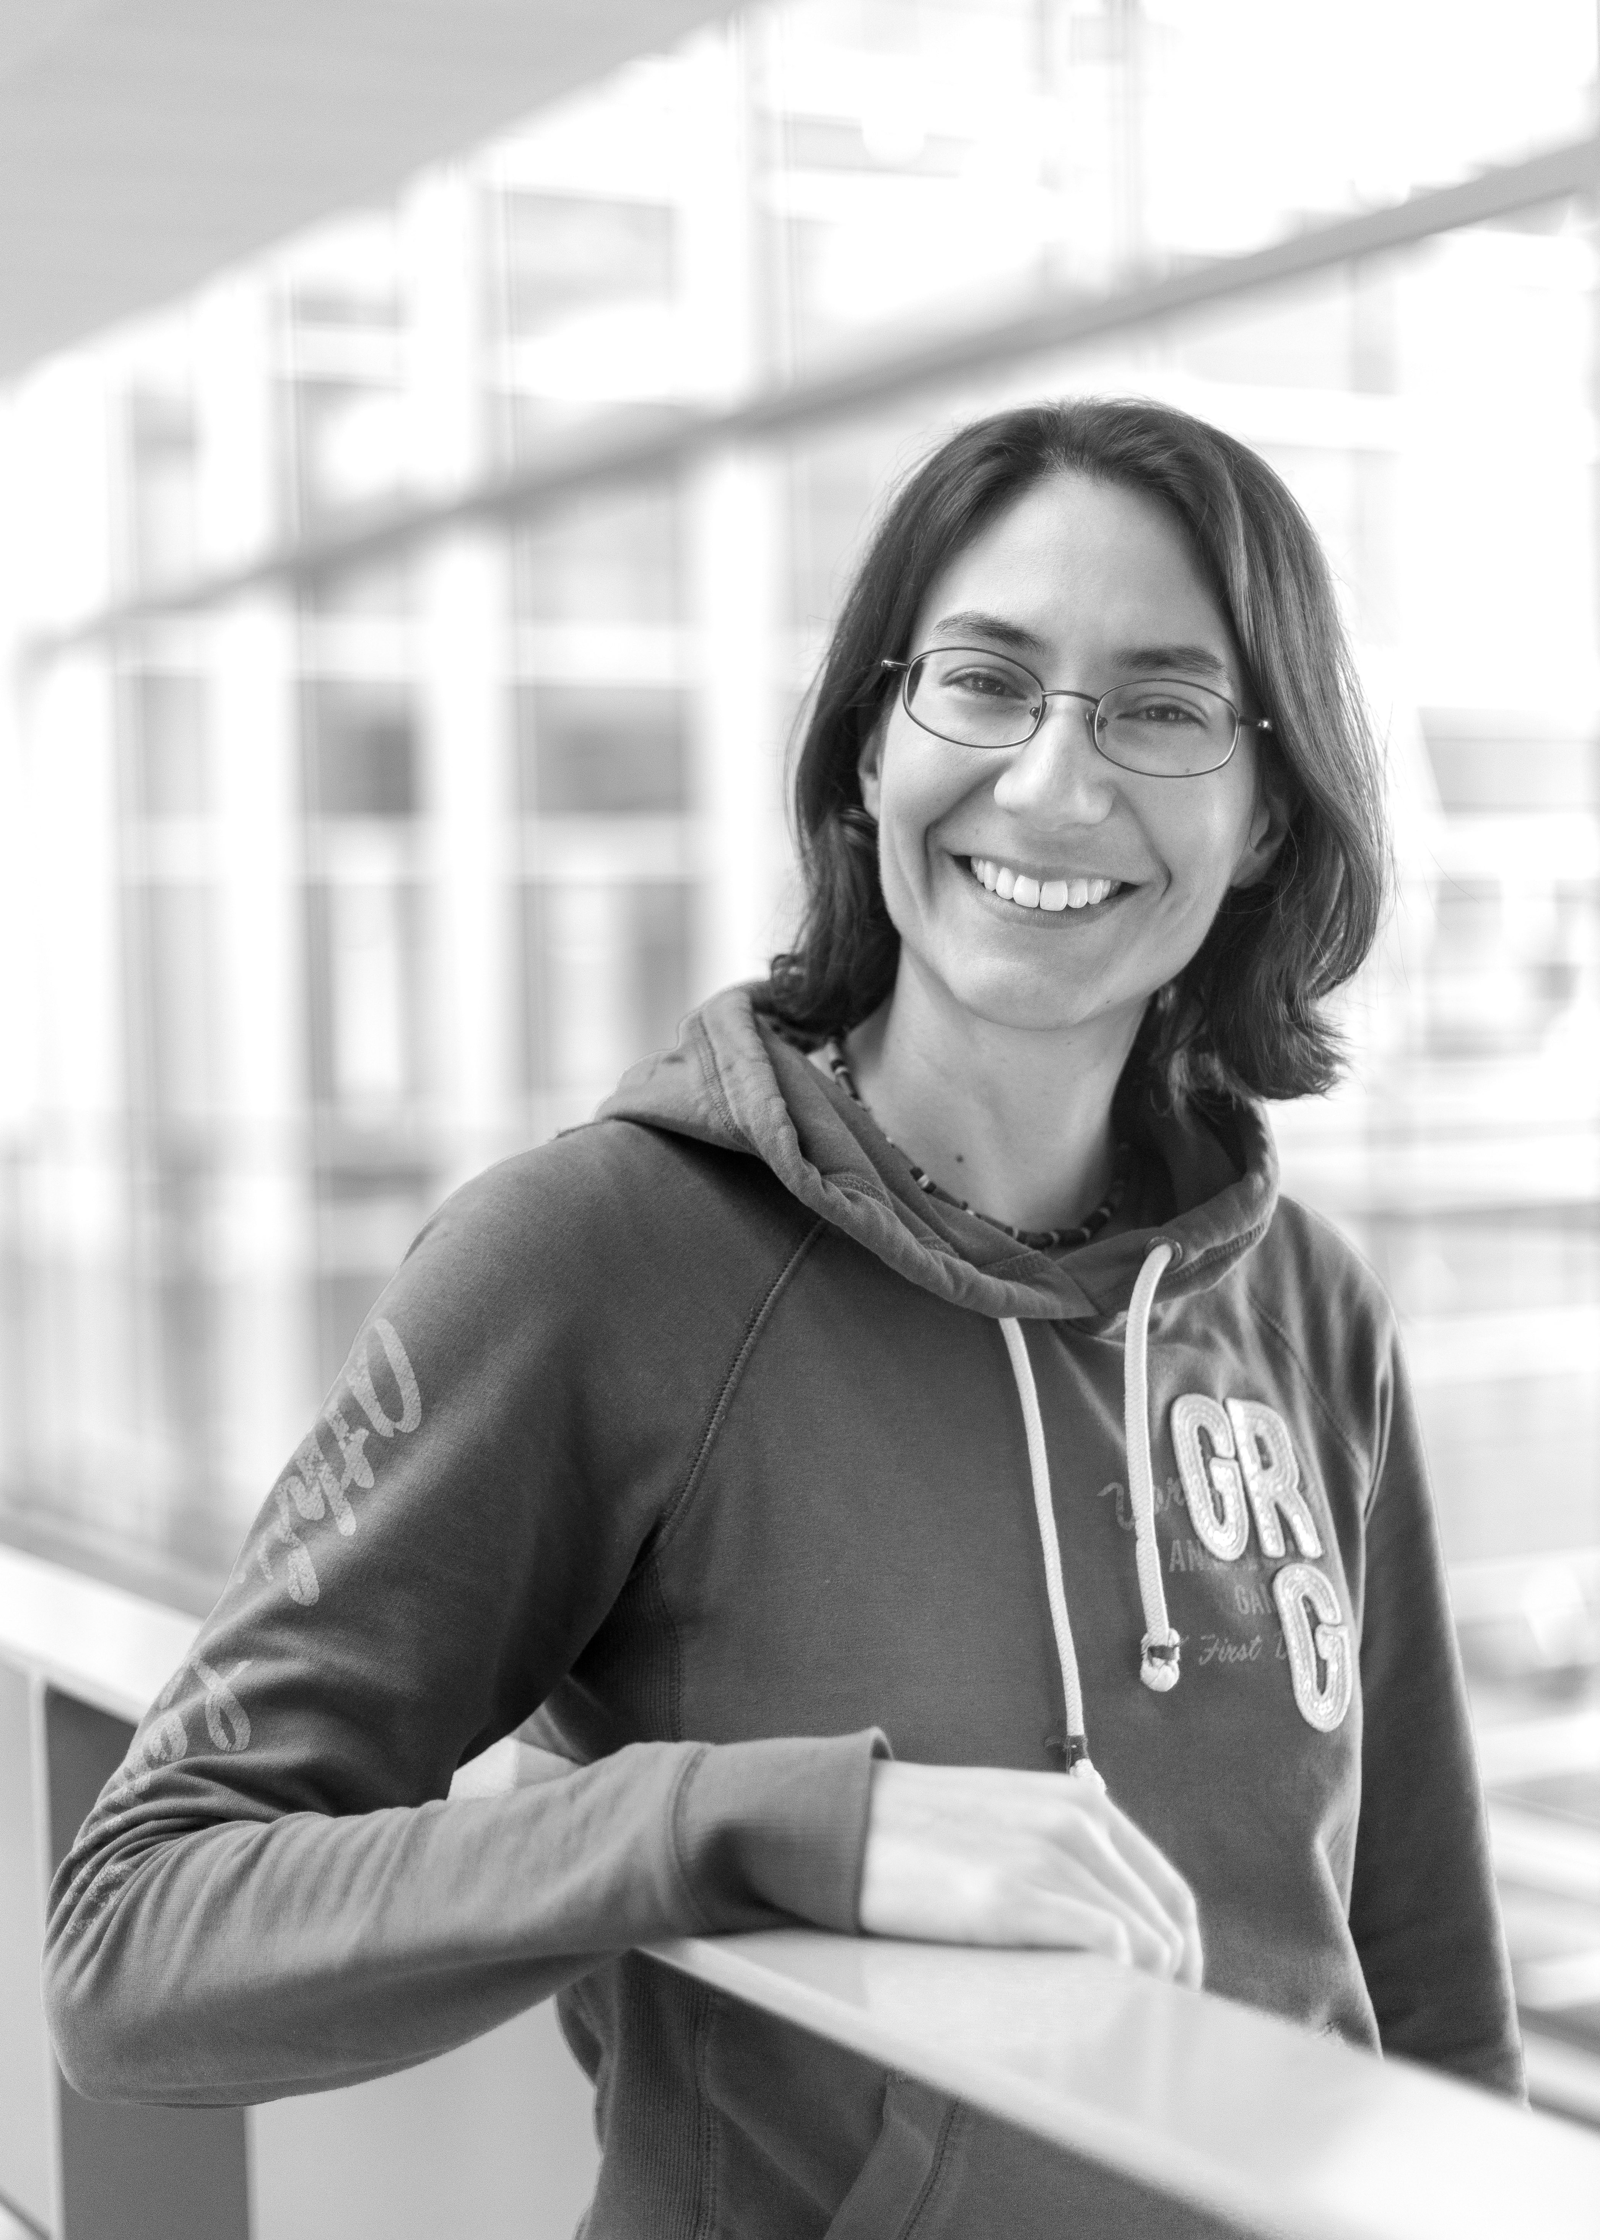

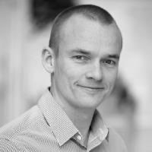
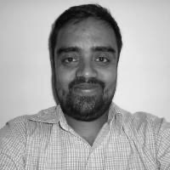
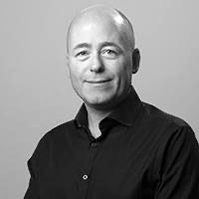
WHO ARE WE
CENTER FOR HEALTH DATA SCIENCE:
Anders Krogh, Professor, Head of Center
Thilde Terkelsen, Data Scientist
DANSTEM:
Magali Michaut, Research Consultant
ANDERS KROGH
THILDE TERKELSEN
MAGALI MICHAUT
GLOBE INSTITUTE:
Bent Petersen, Associate Professor
Shyam Gopalakrishnan, Associate Professor
KU IT:
Allan Have Sørensen, Head of Section
BENT PETERSEN
SHYAM GOPALAKRISHNAN
ALLAN HAVE

Slide 8
C2 WORKSHOP PROGRAM
DATE: 18th of February, 2021
TIME & PLACE: 09.00-16.00 on Zoom
09.00 - Welcome
09.10 - Introduction to Computerome 2.0
09.50 - The Basics
10.10 - Exercise 1.0
10.40 - Coffee Break // Troubleshooting
11.00 - Working on Computerome 2.0
11.20 - Exercise 2.0
11.50 - Q&A
12.00 - Lunch
13.00 - A Technical Intermezzo
13.15 - C2 Modules and Queue System
13.45 - Exercise 3.0
14.30 - Coffee Break // Troubleshooting
15.00 - Optimization of Time and Cost
15.20 - Exercise 4.0
15.45 - Q&A and Outro

Slide 9
PART1
INTR DUCTION

Slide 10
INTRODUCTION TO C2 - BENT

Slide 11
PART 2
THE BASI S

Slide 12
BEFORE LOG IN TO COMPUTEROME 2.0
GETTING STARTED:
https://www.computerome.dk/display/C2W/Getting+Started+-+new+users#GettingStarted-newusers-SSHlogintoComputerome2.0
ACCOUNT
ENTRUST APP
PUTTY OR MOBAXTERM
(WINDOWS ONLY)
THINLINK CLIENT
Request a Computerome 2.0 account (group) in KU-IT self-service. Standard or Sandbox.
Two-factor authentication. Install the Entrust app on your phone or alternatively use the SMS option.
Windows users should have an ssh client. MobaXterm users have to configure their ssh settings - see link.
IF you would like a virtual environment, install the ThinLink Client - make sure to keep it updated.

Slide 13
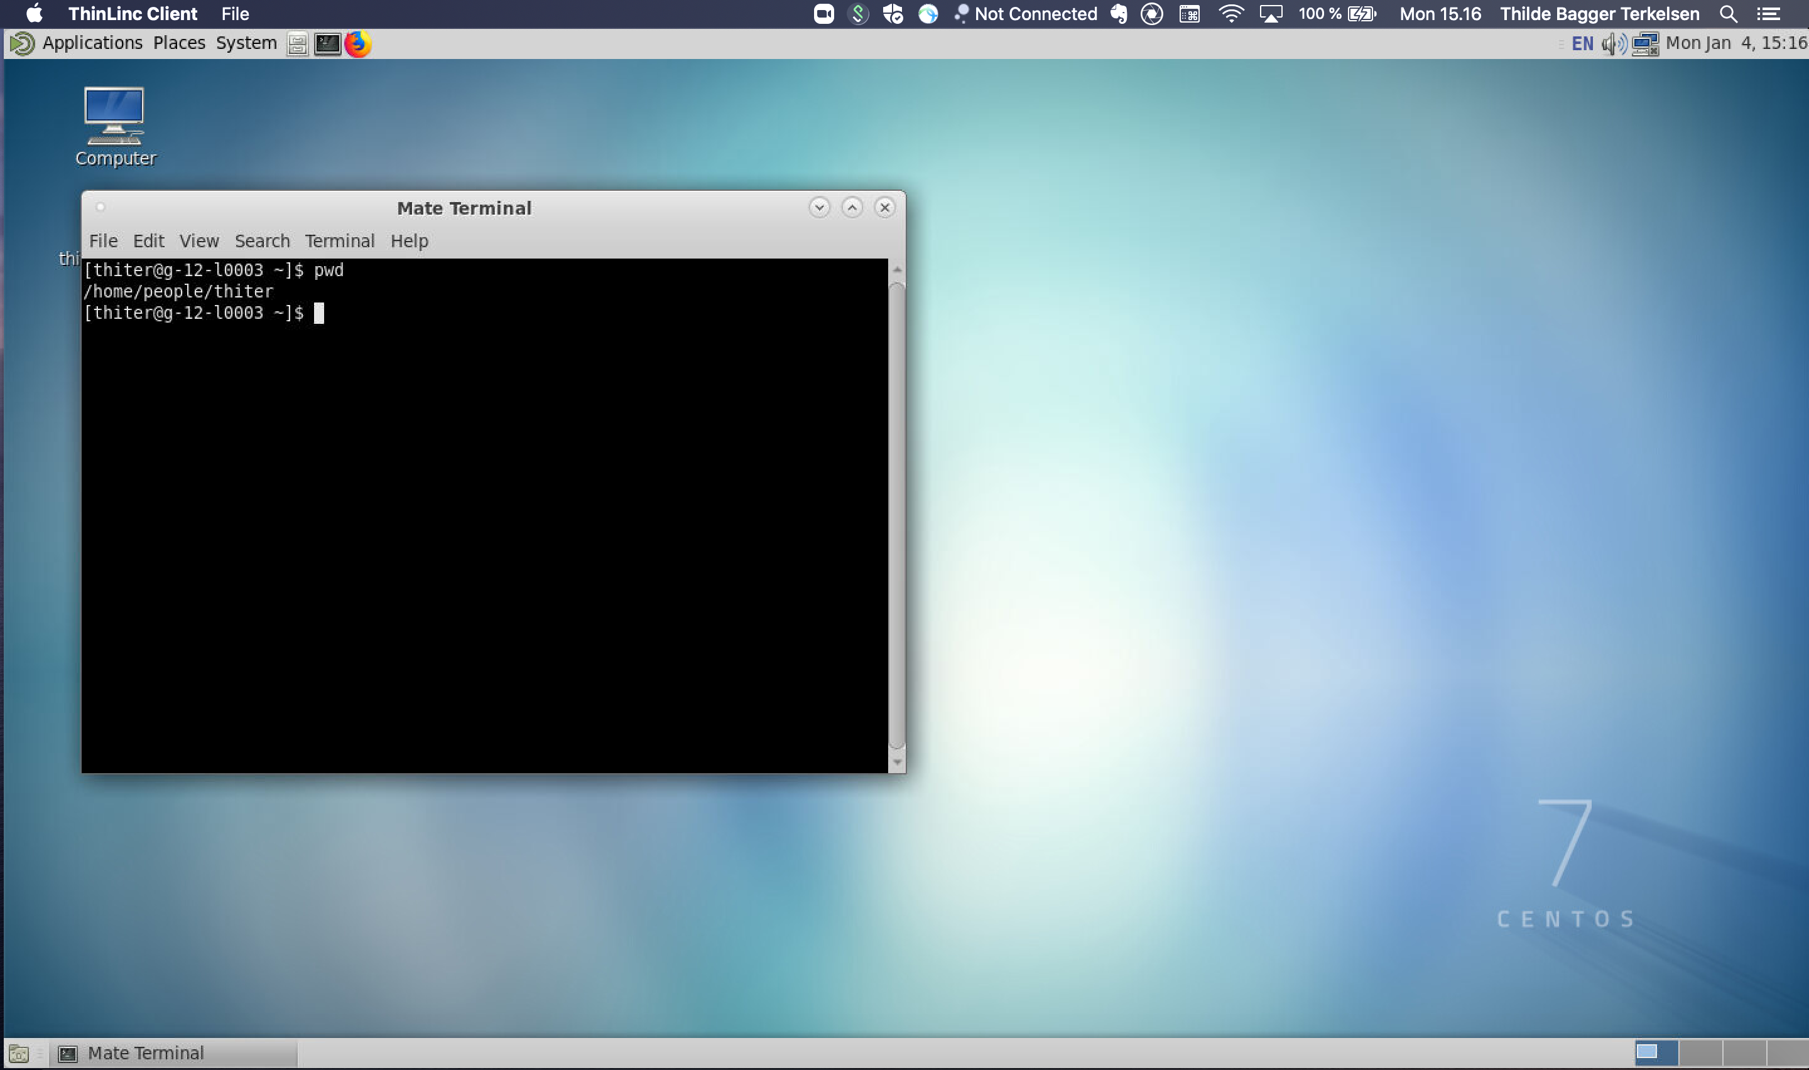
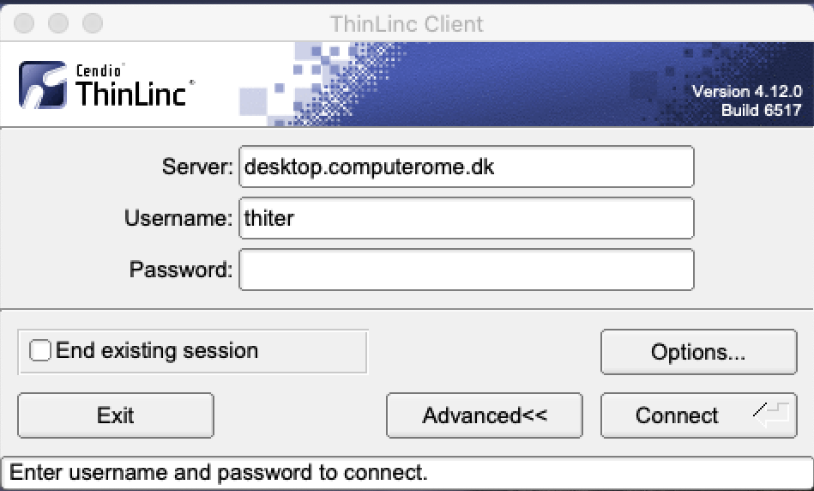
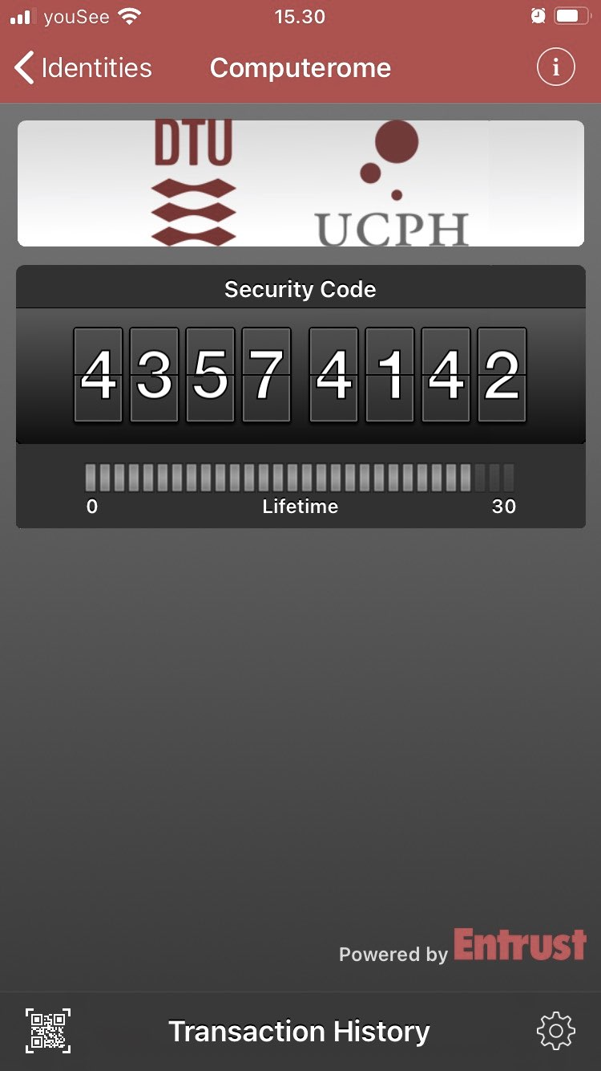
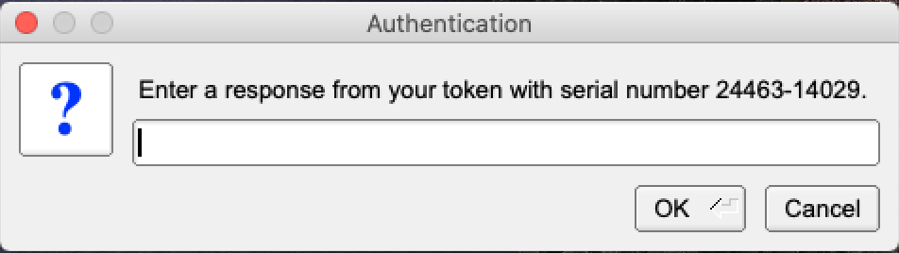
LOG IN TO COMPUTEROME 2.0 2.0
LOG IN WITH THINLINC
Download and install the ThinLinc Client
Open and enter your Username + Password
It make take a couple of minutes to connect
Enter the token from the Entrust App (or Confirm)
Open a terminal or click your way around
Exit a full screen - press the F8 key
LOG IN WITH SSH
>
Open a terminal
ssh username@ssh.computerome.dk
Enter your password
Enter the token from the Entrust App (or Confirm)

Slide 14
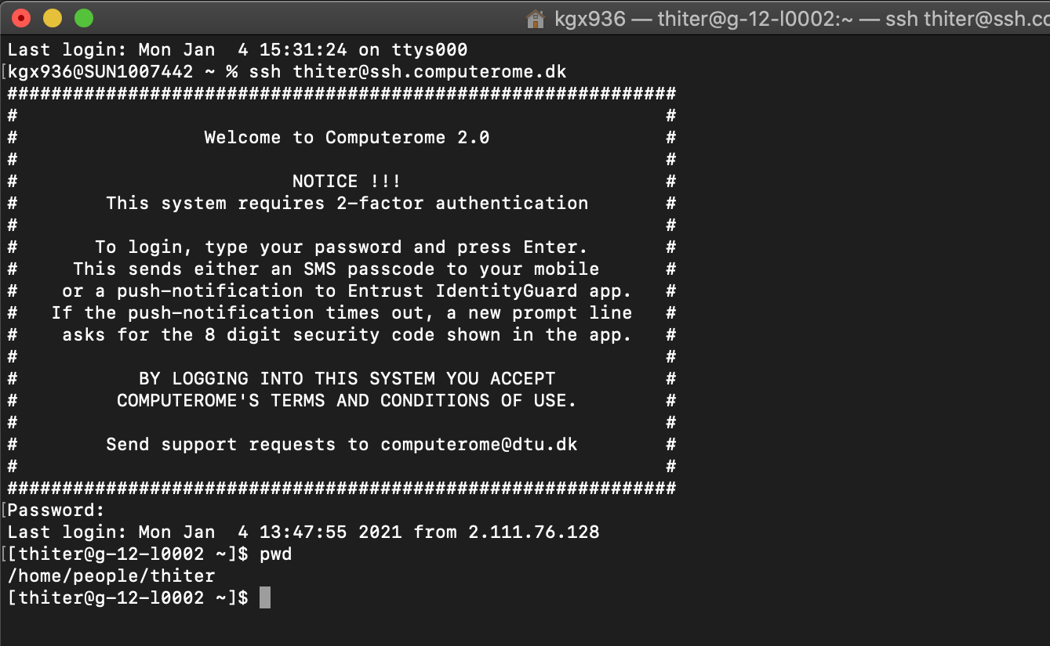
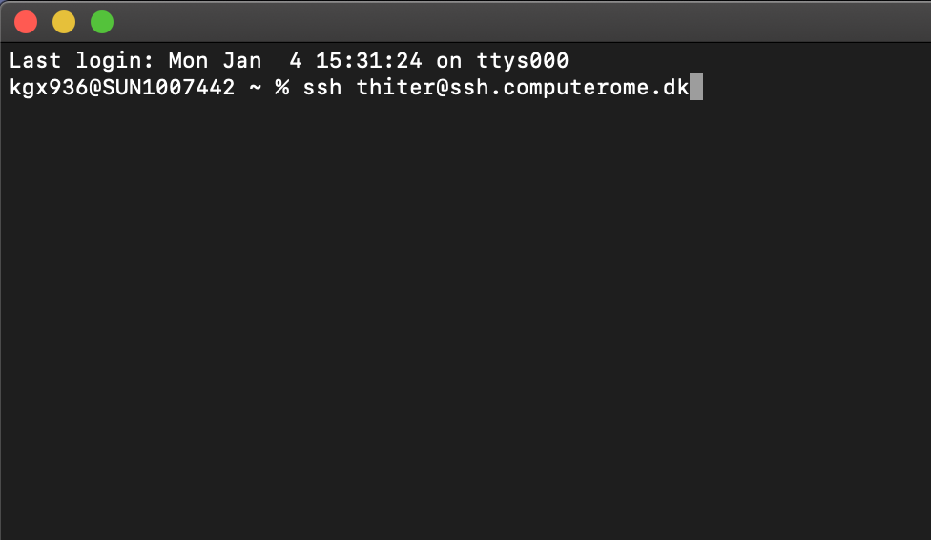
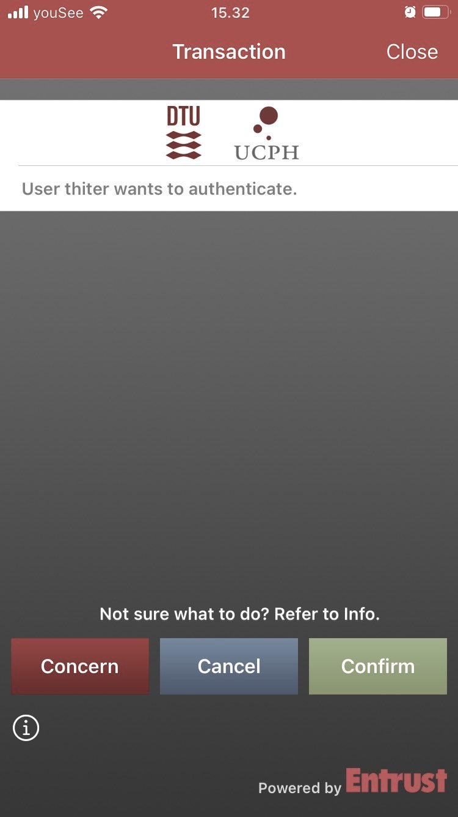
LOG IN TO COMPUTEROME 2.0 2.0
LOG IN WITH THINLINC
Download and install the ThinLinc Client
Open and enter your Username + Password
It make take a couple of minutes to connect
Enter the token from the Entrust App (or Confirm)
Open a terminal or click your way around
Exit a full screen - press the F8 key
LOG IN WITH SSH
>
Open a terminal
ssh username@ssh.computerome.dk
Enter your password
Enter the token from the Entrust App (or Confirm)

Slide 15
C2 SANDBOX STRUCTURE
HOME
DATABASES
PEOPLE
PROJECTS
DB X
DB Y
DB Z
(…)
(…)
PRO 1
PRO 2
PRO 3
(…)
(…)
(…)
(…)
LOG IN
(…)
APPS
DATA
PEOPLE
WORK HERE

Slide 16
C2 SANDBOX STRUCTURE
1
/home/people/username
2
/home/databases
HOME
HOME
Your private directory.
This space is meant for configuration files.
Do NOT store data here (max 10G)
Do NOT run jobs from here.
Shared database resource
Databases include:
PEOPLE
DATABASES
Human genomes
Blast
TCGA / GTEx
dbSNP
ClinVar / COSMIC
…
DB X
DB Y
DB Z
(…)
(…)
(…)
LOG IN

Slide 17
C2 SANDBOX STRUCTURE
3
/home/projects/project
HOME
Your project directory.
./apps : project specific applications & modulefiles
./archive: dataproject specific data
./scratch: temporary & re-creatable data N.B will not be backed up!
./review used for peer-review.
PROJECTS
PRO NAME
YOUR PROJECT
APPS
ARCHIVE
DATA
PEOPLE
REVIEW
SCRATCH
MODULEFILES
RAW
GENERATED
WORK HERE
APPS

Slide 18
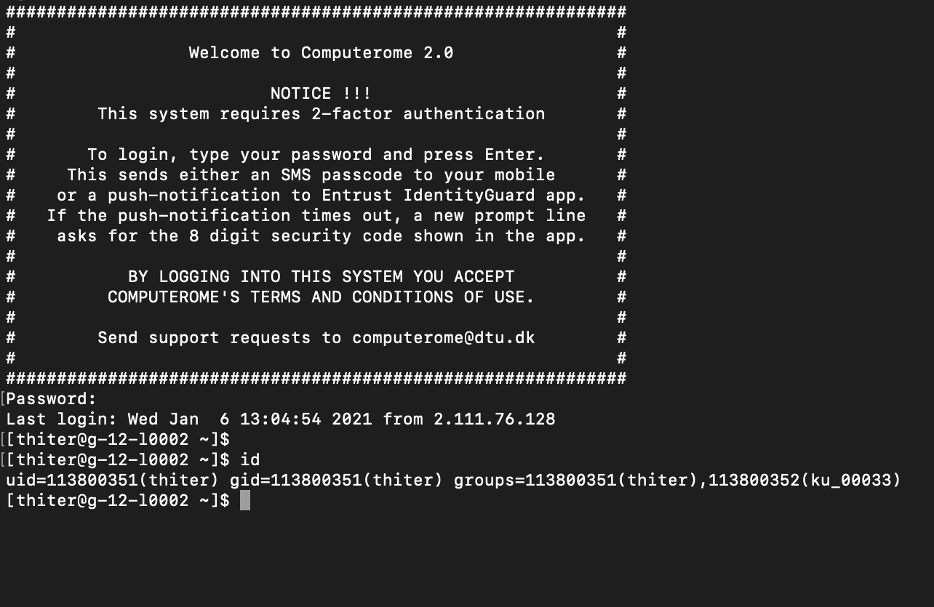
YOUR PROJECT AND GROUP
PROJECT
PROJECT NAME
Type in <id> to get this information
<project> usually refers to the projects funding.
<project_name> is the name given by the C2 team. Almost exclusively the same as <project>.
USERNAME
<username>
Your unique user ID. Can be connected to multiple projects and groups.
GROUP NAME
UNIX
<group_name>
ID assigned by DTU. Refers to the UNIX group, e.g. the projects/users access to resources.
Often the same as <project_name>.

Slide 19
GOOD TO KNOW
COMPUTEROME 2.0 WIKI - FIND EVERYTHING HERE
https://www.computerome.dk/
VIDEO TUTORIALS - HELPFUL TO WINDOWS USERS
https://www.computerome.dk/display/C2W/Video+Tutorials
BRUSH UP ON YOUR UNIX SKILLS
https://www.computerome.dk/display/C2W/Getting+Started+-+new+users?preview=/42205237/42205239/Hackinars_in_Computerome-wiki.pdf
CHECK YOUR USAGE ON C2
module load tools usage_script/2.0
usage -u username
CHECK YOUR USAGE ON C2
GETTING HELP
Write to computerome@dtu.dk
Subject description
System, e.g. Computerome main, sandbox, or <named> cloud system
Login issues, ThinLinc vs SSH login, username & error message(s)
Command line(s) used
Describe the problem including error messages

Slide 20
PART3
WORKING ON COMPUTEROME 2.

Slide 21
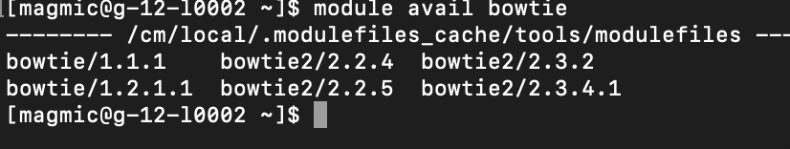
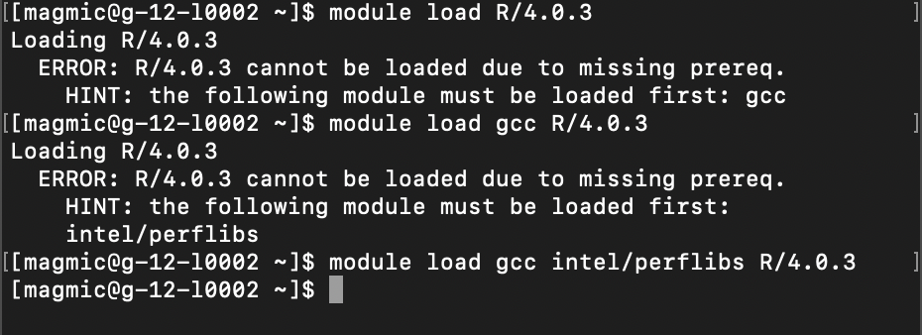
MODULES
>
LOADING A MODULE: MODULE LOAD
You need to load each software you want to use (in its specific version)
module load bowtie/2.3.2
>
SEARCHING FOR A MODULE: MODULE AVAIL
First load the ”tools” module: module load tools
Use the avail function with the start of your software name
module avail bowtie
>
ADDING THE DEPENDENCIES
When there is a missing dependency, follow the suggestions
More on C2 wiki: https://www.computerome.dk/display/C2W/Installed+Software

Slide 22
REQUEST RESOURCES
>
DO NOT START ANY JOB ON THE LOGIN NODE
After you log-in, you can move around and have a look (e.g. cd, ls, cat….)
When you know what you want to do, you need to request the resources first
>
INTERACTIVE MODE WITH IQSUB
Just type iqsub in the command line
This will open a window for you to put the parameters for what you need
>
PLACE A SCRIPT IN THE QUEUE WITH QSUB
Specify the resources needed with PBS commands (e.g. in a PBS script)
Place the script in the queue with qsub
Explored in mode details this afternoon

Slide 23
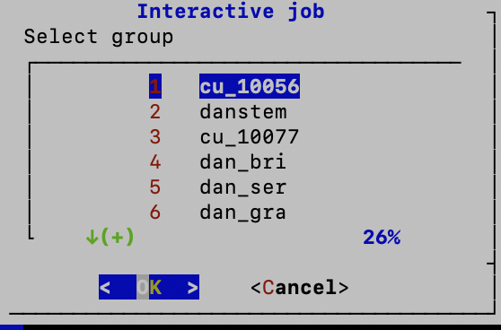
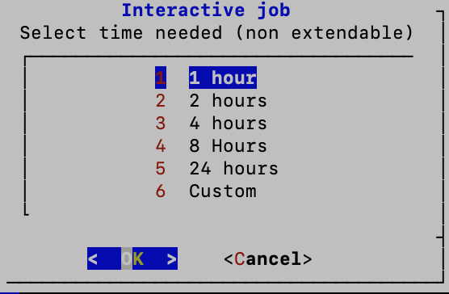
IQSUB PARAMETERS
>
PROJECT / GROUP
As part of which project / C2 group are you working
This affects who is paying
>
TIME NEEDED
This is the wall time. After this time, the resources are close.
Everything you are doing that is not saved is lost.
Better to put a bit longer than what you think you need (you can close before the end)
If you are done, you can exit with command exit ;-)

Slide 24
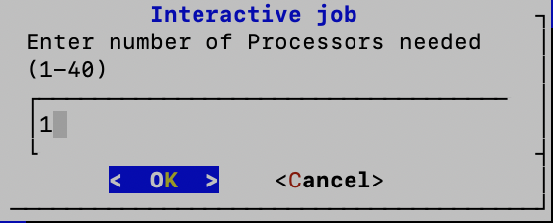
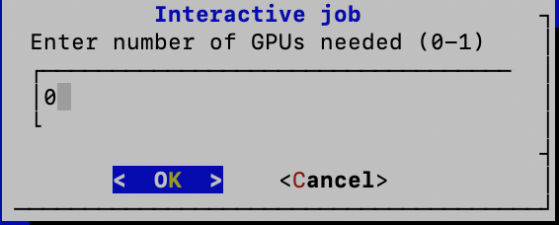
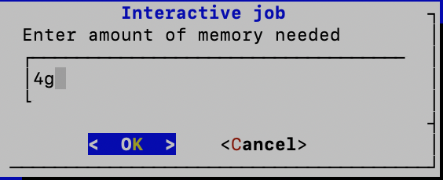
IQSUB PARAMETERS
>
NUMBER OF CPUs
Only useful for jobs that are parallelized and can benefit from several CPUs
If you don’t know, you can leave 1
>
NUMBER OF GPUs
Unless you know you need some GPU, leave it to 0
If you want to use GPU, you put 1
>
MEMORY NEEDED
Depends on the methods / software you use
E.g. mapping with STAR, you might want to increase to 60-80g

Slide 25
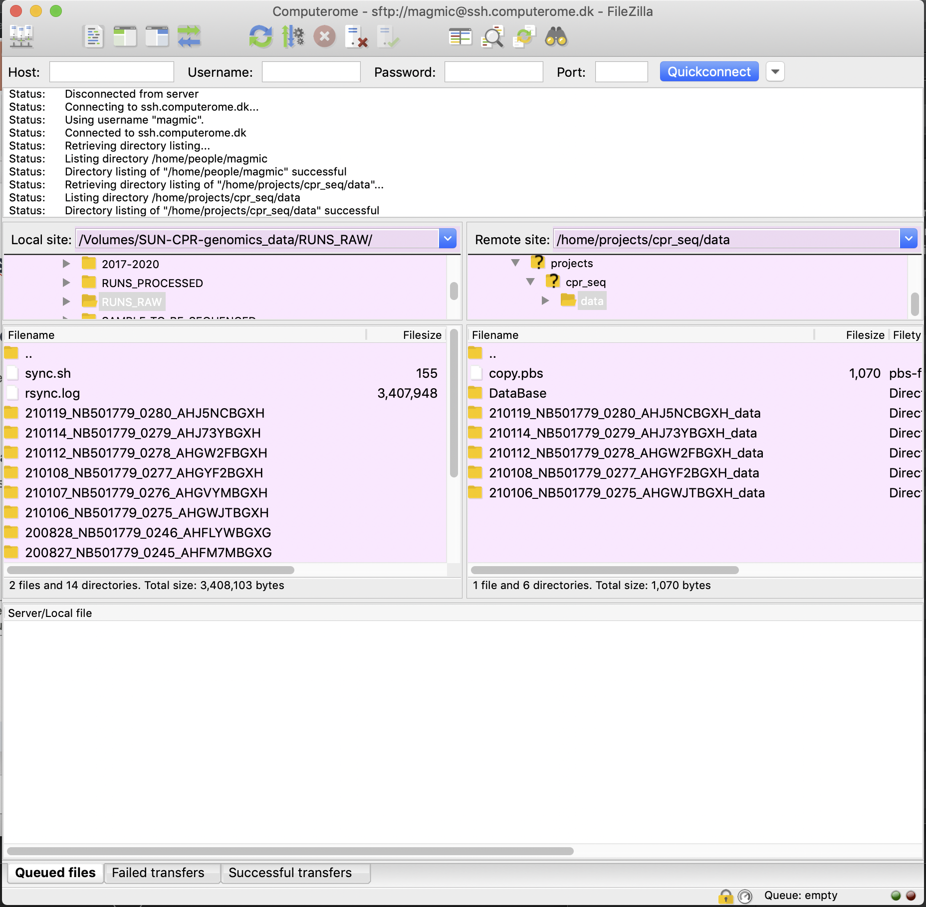
FILE TRANSFER: scp & FileZilla
>
COPY DATA FROM/TO C2 via SCP command
From local to computerome:
scp /Users/path/to/file username@ssh.computerome.dk:/home/path/to/the/destination/
From computerome to local:
scp username@ssh.computerome.dk:/home/path/to/file/ /Users/path/to/destination/
If it’s a whole folder, use -r
For more info, study the scp command (man scp)
>
>
Use FileZilla graphical interface
You can also use a software with a graphical interface
Find on the wiki how to set up the connection

Slide 26
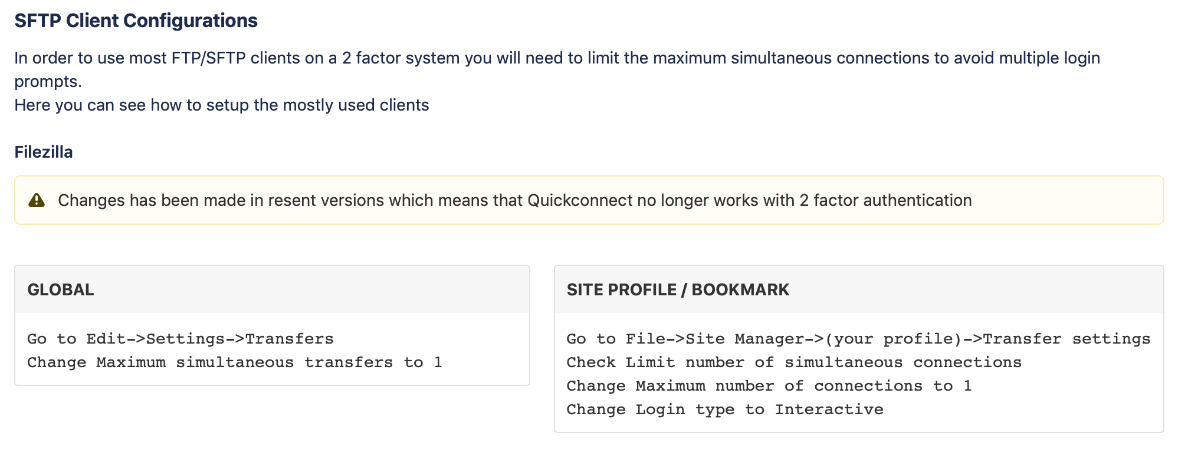
Filezilla configuration
From C2 wiki: https://www.computerome.dk/display/C2W/SSH+login+to+Computerome+2.0

Slide 27
MODULES
>
LOADING A MODULE: MODULE LOAD
You need to load each software you want to use (in its specific version)
module load bowtie/2.3.2
>
SEARCHING FOR A MODULE: MODULE AVAIL
Use the avail function with the start of your software name
module avail bowtie
>
ADDING THE DEPENDENCIES
When there is a missing dependency, follow the suggestions
More on C2 wiki: https://www.computerome.dk/display/C2W/Installed+Software

Slide 28
PART4
A BRIEF TECHNICAL INTERMEZZ

Slide 29
A BRIEF TECHINCAL INTERMEZZO
HOW DO YOU GET ACCESS OR HELP TO COMPUTEROME AT KU?
Get access via KU-IT’s selfservice at https://sd.ku.dk
If you need help, KU-IT can assist with a basic C2 training
More on C2 at KU at KUnet, Employment guide and soon Research Portal:

Slide 30
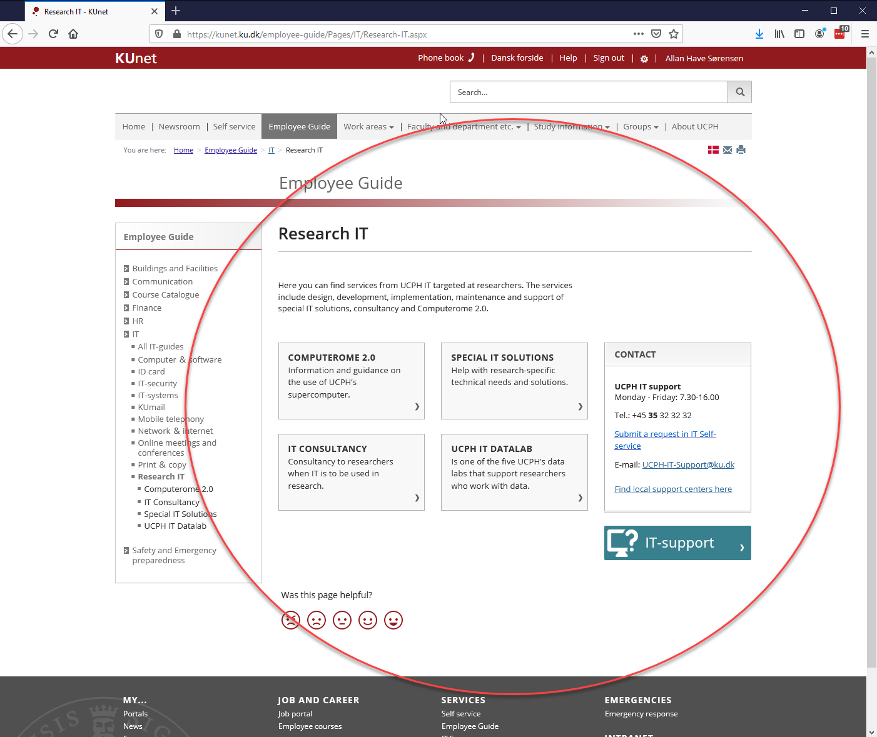
COMPUTEROME AT KUnet

Slide 31
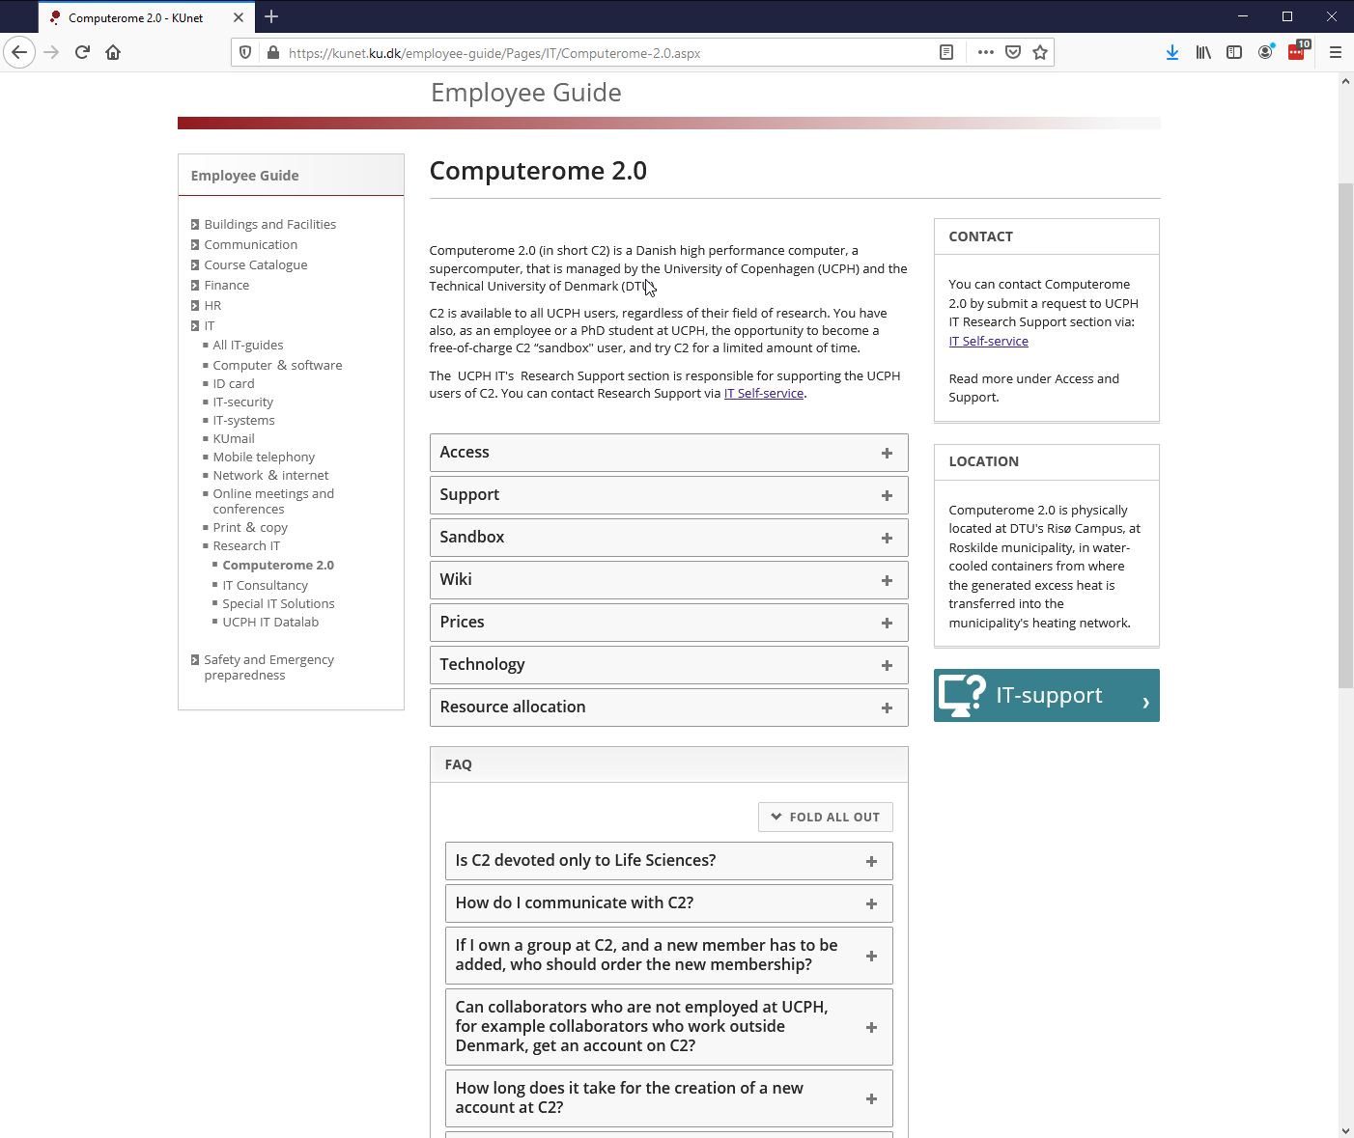
COMPUTEROME AT KUnet

Slide 32
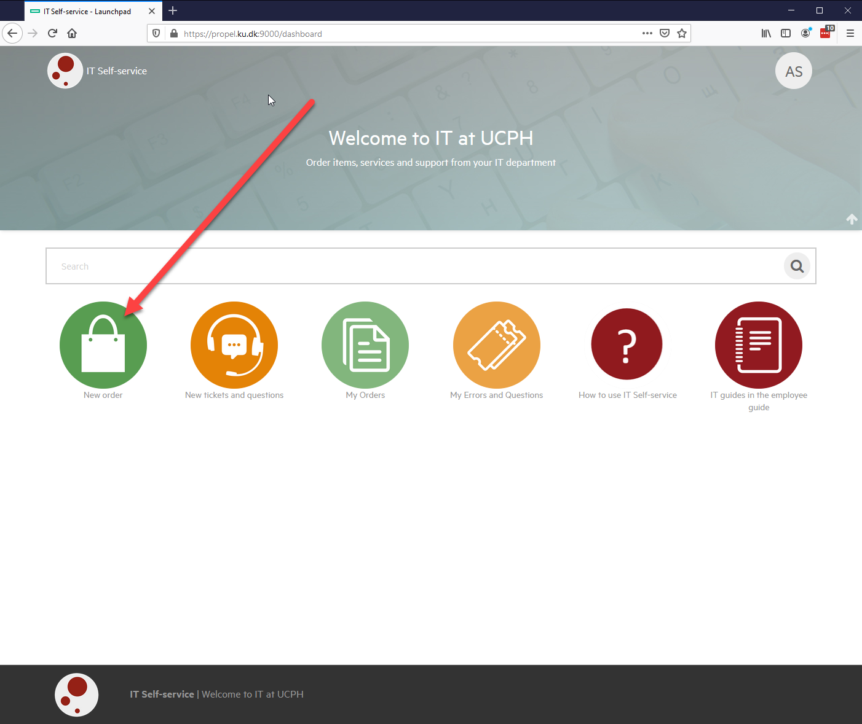
HOW TO CREATE A GROUP

Slide 33
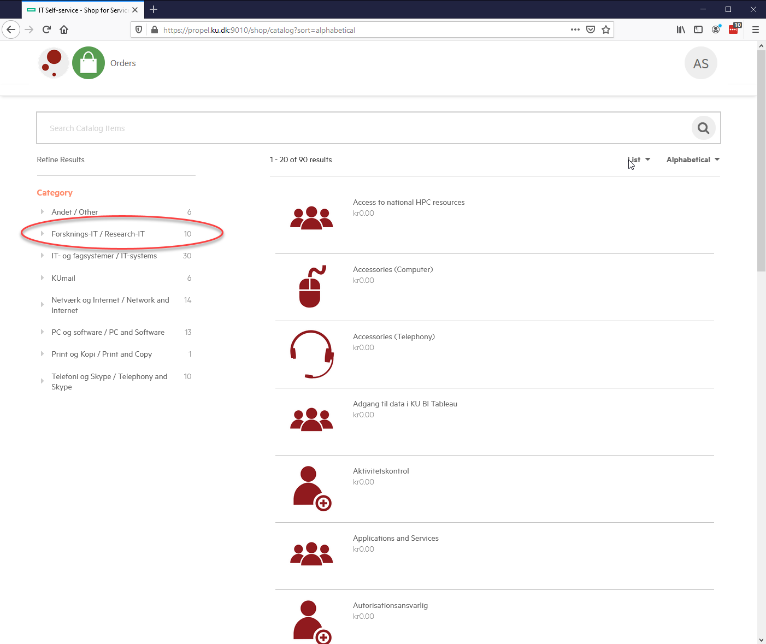
HOW TO CREATE A GROUP

Slide 34
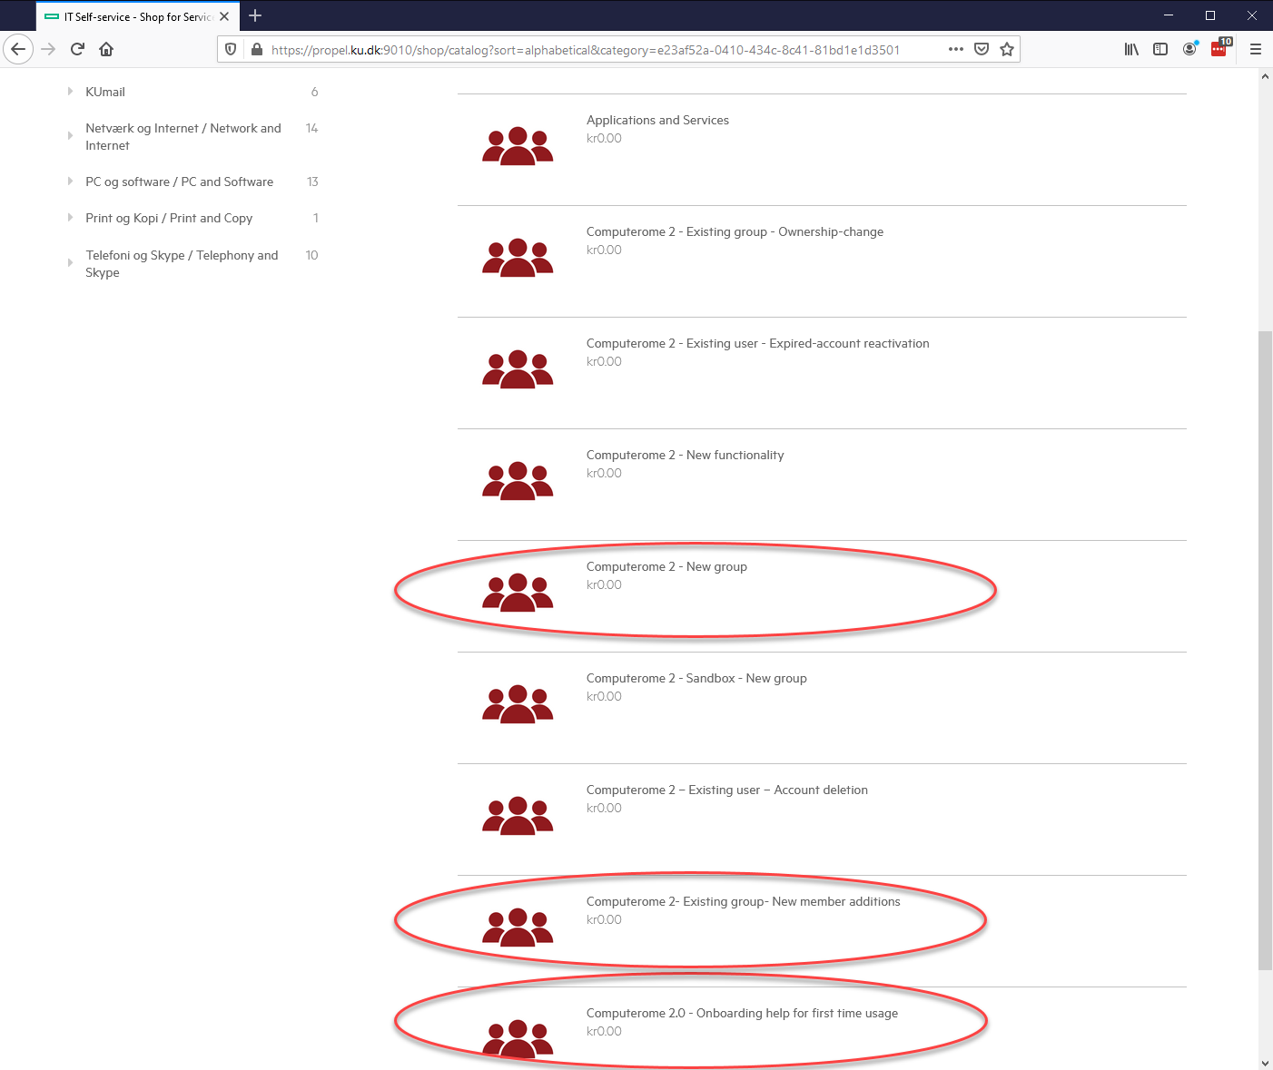
HOW TO CREATE A GROUP

Slide 35
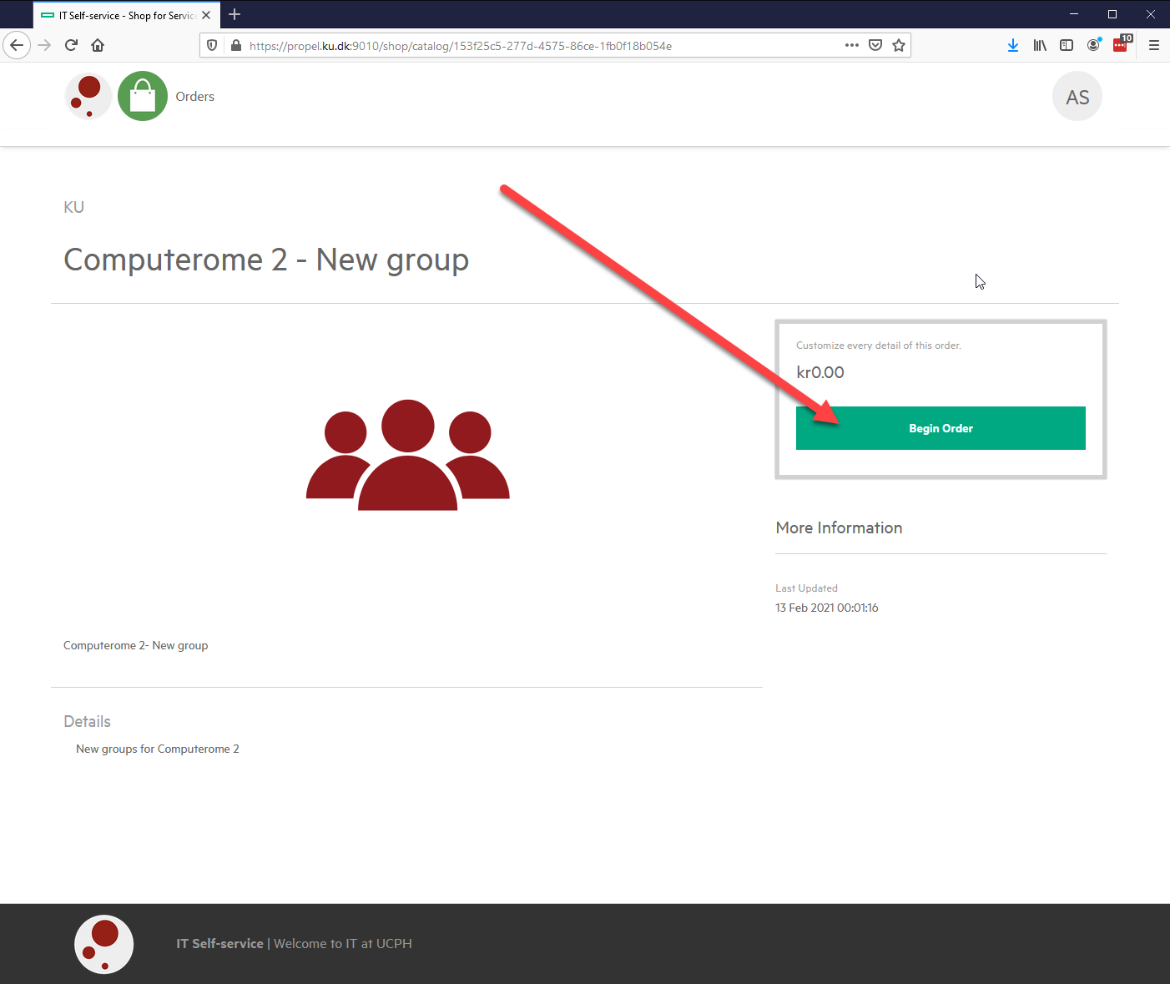
HOW TO CREATE A GROUP

Slide 36
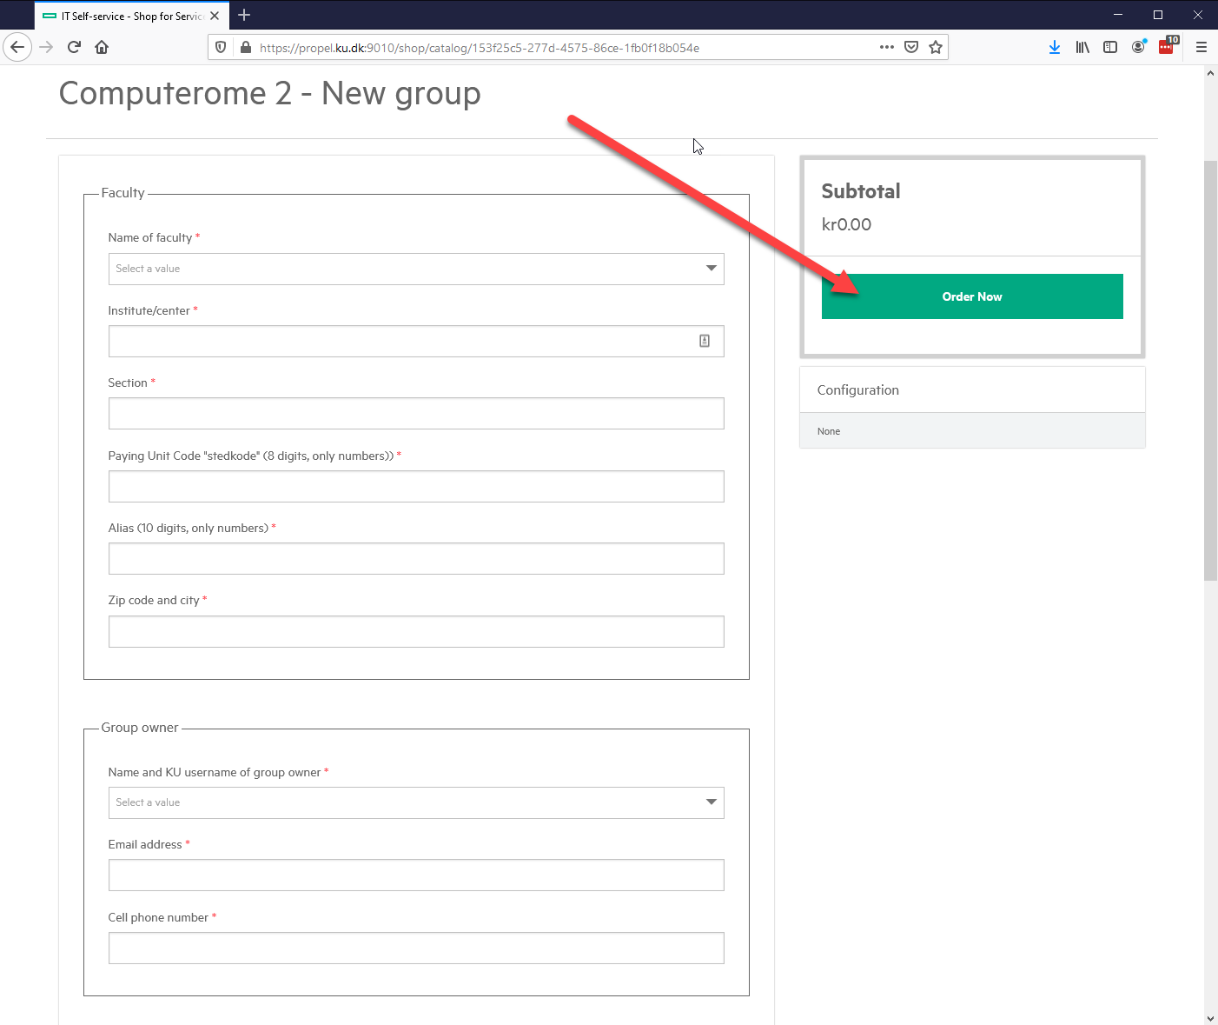
HOW TO CREATE A GROUP

Slide 37
PART5
C2 M DULES & QUEUING SYSTEM

Slide 38
MODULES, QUEUING SYSTEM & SCRIPTS - SHYAM

Slide 39
PART6
OPTIMIZATION OF TIME & C ST

Slide 40
OPTIMIZATION OF TIME AND COST ON C2 - SHYAM

